Slide 2
Use the templates and blank slides in this deck to create an overview of the top insights and take-aways to share with your colleagues.
Add more slides by copy/pasting or add a blank slide by clicking the ‘New slide’ button in the home ribbon.

Slide 3
When finished, save your presentation as a ‘Show’ or ‘Export to video’ to share your take-aways in an easy-to-view format for your colleagues.

Slide 4
Key take-aways from the week
One
Two
Three

Slide 5
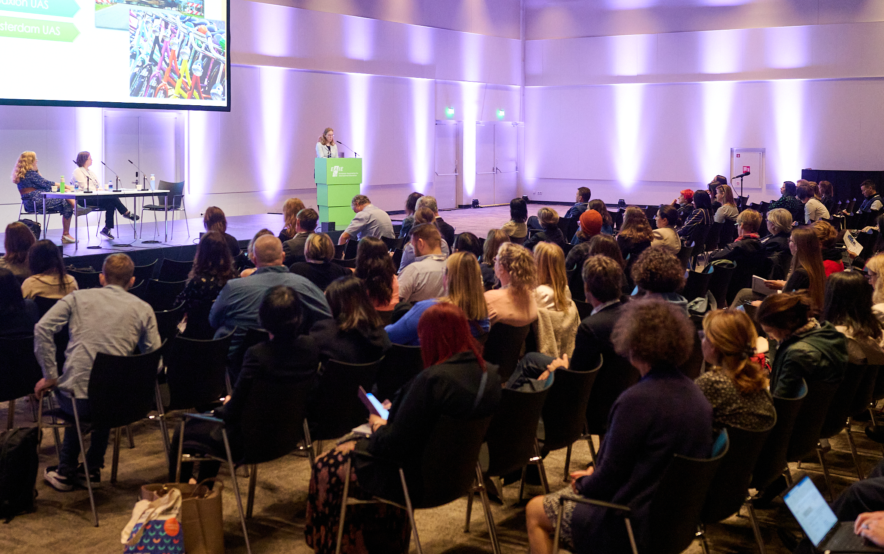
Top sessions
Session name
Session name
Session name

Slide 6
Session name
Session insights
Top tips

Slide 7
Helpful resources
Name of article
Name of publication
Website

Slide 8
Communities of Practice to join
Admission and recognition
Alumni engagement and relations
Climate action and environmental sustainability
Early-career professionals
Erasmus+
European university alliances
Global engagement
Inclusion and diversity
International office management
Internationalisation at Home and of the curriculum
Joint degree programmes
Marketing and recruitment
Online, blended and hybrid learning
Researchers on internationalisation
Risk management and knowledge security
Staff mobility
Strategic partnerships
Strategy and planning
Student mental health and well-being
Student mobility
Summer schools
https://www.eaie.org/my-eaie/community-platform.html

Slide 9
New contacts/partners
Name
Organisation
Email
Name
Organisation
Email
Name
Organisation
Email
Name
Organisation
Email
Name
Organisation
Email
Name
Organisation
Email

