Slide 1
December 2024
Overview of the key reforms and priorities
in Higher Education of Ukraine
Prepared by National Erasmus+ Office
and Erasmus+ Higher Education Reform Expert team

Slide 2
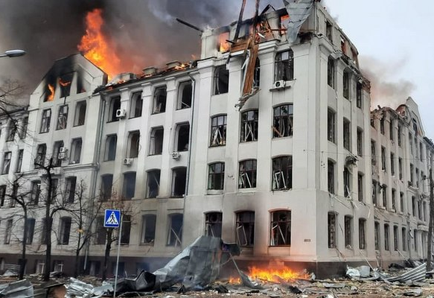
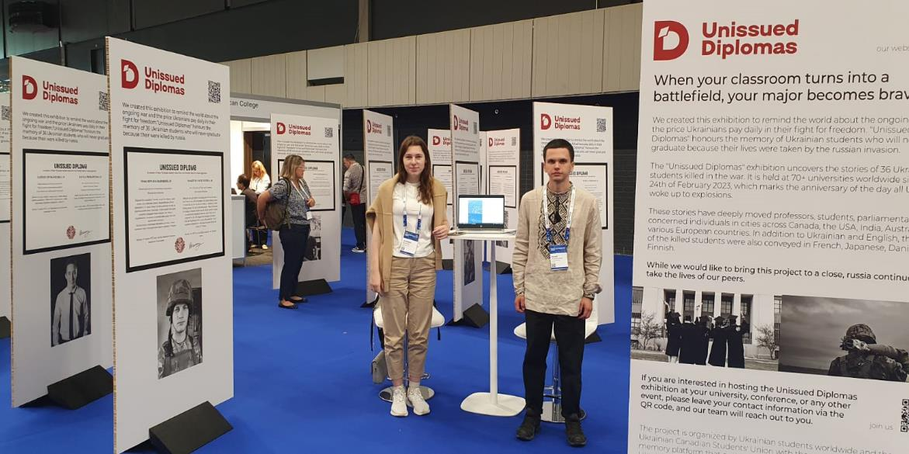
War-Induced losses and challenges of Ukrainian Education during martial law* (since 24.02.2022)
Severe damage of the educational ecosystem:
Human losses among students teaching and admin staff – TRAUMA
3798 education institutions damaged, 365 destroyed completely
War affected 1.5 million young Ukrainians, over 70,000 foreign students
Many education institutions served as shelters and humanitarian hubs
International officers and projects teams&families under danger in occupied territories
34 HEIs, 65 units of HEIs and 45 VET institutions temporarily relocated
Teaching and learning process: from shelters, frontlines and abroad (online/offline/blended formats)
Sirens, electricity cuts, long-term blackouts and its consequences (24/7)
Emotional burnout among students and teaching staff
Enrollment campaign 2024 - a big challenge (1.4 mln. applied)
Brain drain is highest
By Ukrainian artist – Oleksiy Say and founder of
Mediaproject “Ukrainian Witness” – Vitaliy Dejnega
Details here!
* Sourse: https://saveschools.in.ua/en/

Slide 3
Resilient Education Institutions of Ukraine during martial law
Types | Higher Education Institutions (Universities, Academies, Institutes) |  | Academic staff
 | 2022/2023 | 2023/2024 | 2022/2023 | 2023/2024
Total HEIs | 347 (1,053 mln students) | 314 (1,149 mln students) | 120 514 | 115 857
Public HEIs | 246 (1,018 mln students) | 217 (1,114 mln students) | NA | NA
Private HEIs | 101 (0,035 mln students) | 97 (0,035 mln students) | NA | NA
International students | 49 999 | 33 328
 | 34 relocated HEIs due to martial law
978 VET institutions :
575 207 students
71 177 pedagogical staff
195 foreign students
Higher Education Institutions of Ukraine: https://enic.in.ua/index.php/en/uipeng
National Academy of Sciences of Ukraine:
160 research institutes
29 870 staff, incl. 15 530 researchers
260 cooperation agreements with HEIs
5 Sectoral National Academies of Science:
Law, Medicine, Agrarian, Education, Arts
12 701 (12 976 in 2022) Secondary Schools:
3 906 174 (4 041 976 – 2022) pupils
390 089 (401 836 - 2022) teaching staff
Young people (14-35 years old): 10.6 mln.
* Sourse: State Statistics Service of Ukraine; HERE team Library

Slide 4
From Tempus to Erasmus+: Trust(th)!
Experts pool, quality assurance system!
1994-2024: 30 years of successful long-term cooperation!
Building trust: EU to UA HEIs, among Ukrainian HEIs and long-term partnerships: mobility & cooperation projects activities
International Experts Pool EU&UA for Human Capacity to implement reforms via study visits, TOT, projects activities, staff weeks, workshops, trainings, research, conferences etc.
EU expertise: peer learning and mutual understanding of HE system and legislation
MoESU, MoDTU, HEIs, VETIs, NQAA, NQA, ENIC/NARIC – Ukraine capacity building
HERE’s open resources and events on Bologna Process and EHEA Tools implementation
Convergence with EU: modernised curricula, 3 cycles, PhD schools, ECTS, competence-based approach, learning outcomes, QA, NQF, European Studies
INTERNATIONALISATION OF HIGHER EDUCATION

Slide 5
From Tempus to Erasmus+: Resilience
and 3rd Mission!
Cooperation with students and employers' organisations for curricula reform
Strong and reliable projects partners: support during martial law – human, humanitarian help, educational, research and soft diplomacy etc.
Developed HEIs Capacities for Resilience: blended/distance learning, methodologies/ technologies, infrastructure, virtual labs/ resources, recognition mechanisms
Innovative infrastructures for education
3rd mission of HEIs: centers of excellence for communities – social and societal transfers, knowledge and technology transfers
#ErasmusGeneration – Ukraine:
Soft diplomacy – Ambassadors of Ukraine in world: truth, responsibility, justice and trust!
Education, science and cultural diplomacy!
INTERNATIONALISATION OF HIGHER EDUCATION

Slide 6
Ukraine’s Education system 2024 (Education components)
Higher Education - HE
Junior Bachelor
Bachelor
Master
Doctor of Philosophy / Doctor of Arts
Complete Secondary Education
Pre-School Education
Primary Secondary Education
Basic Secondary Education
Field-specific Secondary Education
Vocational Education and Training - VET
First (Initial) level
Second (Basic) level
Third Upper level
Pre-Tertiary Vocational Education

Slide 7
*More information:
Ministry of Education and Science of Ukraine
ENIC-NARIC Network
Higher Education System of Ukraine video
Vocational Education and Training System of Ukraine video

Slide 8
Recognition of Academic (Credit) Mobility
and Qualifications
Recognition of higher education qualifications within the Higher Education system is carried out in accordance with the Law on Higher Education - by the decision of the Academic Council of the HEI.
Within Erasmus+ projects, Inter-Institutional Agreement is a MUST to organise official mobility and recognition of learning outcomes and mobility periods.
Recommendation: to have internal mobility regulations to avoid internal risks regarding the recognition of learning outcomes.

Slide 9
Erasmus+ Projects Resources on Recognition issues
Unified State Database on Education, includes diplomas verification: https://info.edbo.gov.ua/
The ENIC-NARIC center of Ukraine that deals with these issues of recognition of the prior education and apostil among other things (Main (enic.in.ua)
Global ENIC-NARIC network has a page devoted to Ukraine is a helpful resource: https://www.enic-naric.net/page-ukraine-2022
Recorded webinar training on the recognition issues, including the work with the Unified State Database on Education (collected key resources and guides) :
http://cimea.it/ucraina/index_EN.html
EU publication on the fast track recognition: Guidelines on fast-track recognition of Ukrainian academic qualifications | European Education Area (europa.eu)
Ministry of Education and Science of Ukraine: emergency portal Education System in Ukraine - Ukrainian education in emergency (mon.gov.ua)
Academic Hub for Recognition: https://academicrecognition.eu/

Slide 10
Bologna Process implementation and key reforms (2014 -2019)
The Law on Higher Education (2014 with amendments 2017-2024):
4 cycles:
PhD / Doctor of Arts (3rd cycle, 8th level of the NQF)
Master (2nd cycle, 7th level of the NQF)
Bachelor (1st cycle, 6th level of the NQF)
Junior Bachelor (short cycle, 5th level of the NQF)
European Credit Transfer and Accumulation System (ECTS)
QA system in line with ESG
Academic, organisational, personnel autonomy (no financial autonomy yet)
National Qualification Framework
Diploma Supplement
Competence-based and student-centred approaches, Learning Outcomes
Academic Mobility and Joint programmes
National Agency for Higher Education Quality Assurance (established in 2016, operated since 2019)
* Sourse: Recent Developments in Higher Education of Ukraine

Slide 11
Bologna Process implementation and key reforms since 2014-2019
Law on Education (2017) with (amendments 2018-2024):
National Agency for Higher Education Quality Assurance (NAQA) fully operational since 2019
(4000+ accreditation experts pool and about 7000 study programs accredited by 2024)
National Qualification Framework (NQF) is harmonized in line with QF EHEA and EQF LLL
National Qualification Agency (2019) responsible for NQF, professional standards and Qualification Recognition
* Sourse: Recent Developments in Higher Education of Ukraine

Slide 12
Bologna Process implementation and key reforms (2019-2022)
NAQA prepared for entry into ENQA/EQAR
PhD reform – adoption of a new legal framework for dissertation defenses and PhD study
Strategy for the Higher Education Development in Ukraine (approved on February 23, 2022, the Cabinet of Ministers) is developed in line with European Integration prospects as well as EHEA principles.
Regulations “On the approval of the Procedure for the implementation of the right to academic mobility (updated in May 2022, the Cabinet of Ministers ) internships (for practical skills development) and language internships were added as forms of academic mobility, the right to mobility was extended to the VET institutions students.
List of Fields of Study and Programme Subject Areas in Higher Education based on the Fields of Education and Training 2013 (ISCED-F 2013) (updated in 2022, the Ministry ) – 29 Fields of Study (Narrow fields of education and training, ISCED) and 122 Programme Subject Areas (Detailed fields of education and training, ISCED)
* Sourse: Recent Developments in Higher Education of Ukraine

Slide 13
Current Higher Education reforming in Ukraine
(2024)
Law on Amendments to the Law of Ukraine “On Higher Education” on Individualized Learning Pathway (approved, 2024): expanding the opportunities of students to form the individualized learning pathways, as well as expanding the autonomy of HEIs in the development and implementation of interdisciplinary educational programs, recognition of non-formal/informal education
Law on Amendments to the Law of Ukraine “On Higher Education” on expanding the rights of student self-governance bodies and ensuring the rights of students
Law of Ukraine “On Academic Integrity” (1st reading, 2024)
Law of Ukraine “On National Qualification system” (approved, 2024)
On April 2, 2024 the Cabinet of Ministers of Ukraine adopted a resolution "On Amendments to the Rules for Crossing the State Border by Citizens of Ukraine"
* Sourse: Recent Developments in Higher Education of Ukraine

Slide 14
Current Higher Education reforming in Ukraine
(2024)
State funding for HEIs based on the following criteria (Regulation of the Cabinet of Ministers, 2024)
Сontingent of students - the total number of students who study at the expense of the state funding
Research activity - the amount of funds (calculated per academic employee) that HEI earned from the provision of research and consulting services or received in the form of grants for research
Internationalisation — position of HEIs in international University ranks and/or participation in Erasmus+ projects
Employment track— the percentage of graduates who are employed (data from the Pension Fund)
Regional coefficient — to support HEIs in the most vulnerable, currently front-line regions
* Sourse: Recent Developments in Higher Education of Ukraine

Slide 15
Higher Education reforming in Ukraine
Initiatives of the Ministry of Education and Science of Ukraine*
Reformed content for the “regulated professions” – Medical, Maritime, etc.
Expansion of dual (cooperative) study programmes – study + work for ECTS credits
Particular emphasis on STEM and Computer Science – Master level
Transformation of funding mechanism – introduction of the state grants for students
Autonomy
Organisational autonomy – preparation of an experiment to strengthen the role of the Supervisory Board (stakeholders) in economic activity and decision making on leadership assignment / election
Personnel autonomy – assignment of academic titles (Professor, Assistant Professor) by HEIs
Financial autonomy – restoration of the Formula for the distribution of state funding in HE
Mergers of HEIs – modernisation and transformation of the HEIs network (217 public universities, MESU, 2023)
*Ministry of Education and Science of Ukraine

Slide 16
Priorities of VET reforms*
The network of VET schools and professional pre-higher education institutions is effective and has modern infrastructure
VET and professional pre-higher education ensure the acquisition of educational and professional competencies for personal development and successful careers
VET schools and professional pre-higher education institutions are attractive and prestigious for learning and working
Educational institutions effectively utilize their organizational, academic, and financial autonomy and receive results-oriented funding
VET schools and professional pre-higher education institutions have established partnerships with businesses
*Ministry of Education and Science of Ukraine

Slide 17
Higher Education reform in Ukraine today
All the efforts for the Victory of Ukraine!
Redesigning the University Strategies considering challenges of the wartime and post-war recovery
Enhancement of the digitalisation of teaching and learning excellence
Strengthening the internationalization of higher education, e-internationalization
Third mission, University-Community partnership under focus
Academic contribution to the European integration processes (EU studies, European Studies)
Redesigning, upgrading educational programs, establishing (joint) new (media literacy, cyber security, Post trauma and mental health, Ukrainian studies, curricular for negotiators and translators/interpreters on EU negotiation and accession stages, Resilience Studies etc.)
Inclusive education
Peace Education as Transformative Pedagogy
Special study programs for the demobilized soldiers and veterans, their reintegration in society

Slide 18
Needs of Ukrainian HEIs coping with challenges of martial law
Development/redesign inclusive&universal curricula and establishment of inclusive ecosystem
Modern curricula – professions of the future
Open access of staff and students to innovative courses, resources and infrastructures, virtual labs
COILS, virtual, blended and physical mobility for exchange for staff and students
Inclusive teaching and learning excellence trainings on modern methodologies and technologies
Joint Programmes and courses teaching and learning in English or other foreign languages
Joint research
Mental health recovery, project writing skills, presentation skills and other soft skills trainings for staff and students
E-solutions for the University governance
Infrastructure: laptops, minielectrostations or generators, (mirror) servers, virtual labs – access and creation, artificial and added reality, simulators etc.

Slide 19
Ukrainian Scholars and Students - Ambassadors of Ukraine
Giving lectures on Ukraine across the world
Speaking at International conferences, world forums
Initiating “Ukrainian Studies” and “The Ukrainian Language”
Contributing intellectually to the academic environment of host institutions
Intensifying joint research partnerships
Demonstrating high level of commitment to their home institutions and dedication to support and contribute to the education process in the extremely difficult conditions of war
Promote Ukraine among international students for Study in Ukraine
Erasmus+
Soft diplomacy – Ambassadors of Ukraine in world: truth, responsibility, justice and trust
Education and science diplomacy!

Slide 20
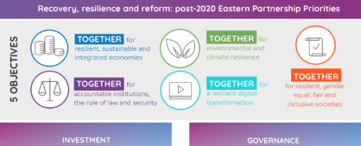
Strategies: UA – EU – World
National Platform for the Recovery Plan of Ukraine
National Priorities
of Reforms in Education and Science:
affordable and quality
pre-school education
- New Ukrainian School - download;
- modern vocational education;
quality higher education and development of adult education
development of science and innovation
innovative infrastructure
- Vision on the Future of Education and Science of Ukraine
- Higher Education Strategy 2032; MoES Ukraine Action Plan 2027
- VET Strategy 2023
- Adult Education Law Draft
- Ukrainian Youth Strategy 2030: Safe, Healthy, Capable, Integrated Youth
- Strategy in Sport
- Inclusive Strategy
- Ukrainian Global Innovation Vision 2030
- EU Enlargement Policy for Ukraine
- Roadmap to EU Membership
https://ehea2024tirane.al/2024-tirana-communique/

Slide 21
Національні пріоритети для проєктів: за участі МОН України (Strand 3 чи 2 якщо плануєте )

Slide 22
National Priorities for projects recommended by the
Ministry of Education and Science of Ukraine:
European Integration of Ukraine in curricula / courses / modules
Negotiation process on accession of Ukraine to European Union
✔ European Values
✔ European Dimension on education in history – Study of history of Ukraine and EU member states via common context
Education of translators/interpreters for accession to European Union
✔ interpretation and translation from/to official languages of European Union
✔ European Master's in Translation (EMT)
Higher Education for the post-war recovery
✔ prosthesis-orthotics, rehabilitation and psychology, demining and ecological recovery
✔ cooperation with business (construction and architecture, agriculture, biotechnologies)
✔ involvement of high quality human resources (joint PhD programmes, industrial doctorates, job shadow / traineeships at enterprises)
✔ HEIs in post-war recovery of regions and communities (SDG, green and digital transitions)

Slide 23
National Priorities for projects recommended by the
Ministry of Education and Science of Ukraine:
Inclusive and innovative Higher Education area for the 3rd mission of University
✔ strengthening of social dimension of Higher Education in EHEA (Rome Communique 2020, Tirana Communique 2024)
✔ Higher Education Institution as a driver of recovery of region and return of Ukrainians from abroad
Individualisation of Learning Paths in Higher Education
✔ models of manage of processes for individual learning path and flexible periods of study
✔ interdisciplinary Bachelor programmes, Dual Bachelor and Master programmes
✔ national / internal and international mobility of students
English as a lingua
Franca of higher education
✔ English language as means for communication, teaching, learning, research
✔ Study Programmes developed in English language
Рedagogical (Teachers) Education Reform
✔ modernisation of approaches to the education and professional development of teachers under uncertainty
✔ development of approaches to support for sustainability of human resources (teacher retainment) for learning and teaching
✔ diversification of ways for access to teacher’s profession

Slide 24
National Priorities for projects recommended by the
Ministry of Education and Science of Ukraine:
Open Science in Higher Education Institutions
✔ study programmes and trainings on the Open Science principles and science data management
✔ data stewards at the Higher Education Institutions
✔ implementation of the Open Science principles and good management of scientific data (FAIR principles – Findable, Accessible, Interoperable, Retrievable)
✔ thematic (sectoral) science data repository, intersectoral exchange of scientific data
✔ exchange of experience of best practices in the Open Science sphere
Неофіційний переклад від НЕО в Україні
Першоджерело: презентація МОН України
Офіційний лист з пріоритетами та процедурою попереднього відбору проєктів де плануєте залучати МОН України надійде згодом до ЗВО України

Slide 25
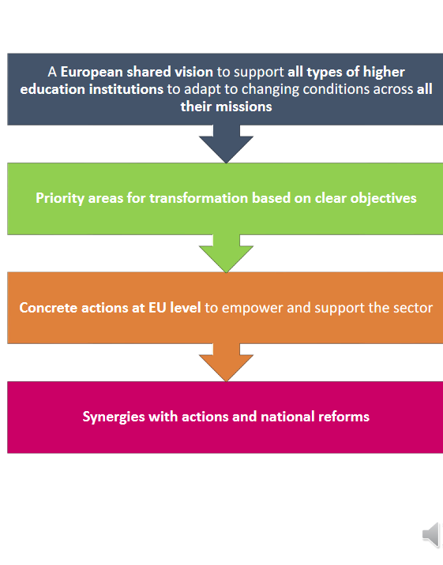
Tirana Communique and other Documents
https://erasmusplus.org.ua/en/news/enea-ministerial-conference-2024-29-05-2024-tirana/
40 Ukrainian universities has joined 25 European Universities Alliances to work together on challenges
European Universities Strategy Document

Slide 26
International cooperation during martial law
April 2022 – December 2024: increased internationalisation
From survival mode to transformation approach:
individual support: scholarships, study/traineeship, teaching, training, research (bilateral agreements)
projects to respond challenges of martial law: Erasmus+, Horizon Europe, other EU’s initiative, OeaD, DAAD, French Institute, SI, GIZ, EAIE, EUA, EUF, IAU, British Council, Twinning, World Bank, USAID etc.
structural and institutional support (HRD, capacities, equipment purchase for relocated HEIs etc.)
€ 5 million for digital ecosystem in higher education
2 new calls for youth and sport capacity building
40 HEIs joined European Universities Alliances
47 projects for capacity building in higher education
223 projects for European Studies of Jean Monnet
1000 other projects in education, youth and sport
relocated russian budget to Ukraine
ERASMUS+ SOLIDARITY WITH UKRAINE:
200 million euros for Ukrainian students and staff
€4.43 billion for projects supporting Ukraine!
Over 3,000 Ukrainian teachers with access to eTwinning educational resources; 1,5M books for Ukrainian school pupils were published; school buses provided.
More opportunities opened: about 40 calls for proposals
More projects funded: education, youth and sport
More access to networks, resources and platforms: eTwinning, EPALE, EQF, Eurydice, Euroguidance, Europass etc.
€10 billion from the 2022 REACT-EU

Slide 27
Ukraine in Erasmus+ 2021-2024
8,173 international mobilities for Ukrainians’ Universities staff & students
205 universities from Ukraine are on Erasmus+ mobility
1026 projects for leaning mobilities for young people (13-30 years old), youth workers and active citizenship exchanges;
9 Virtual Exchanges projects in higher education and youth, 16 HEIs, 6 NGOs;
13 Erasmus Mundus Joint Master Programmes design and implementation projects at 11 HEIs;
138 Master Degree students scholarships provided to Ukrainians;
180 Cooperation Partnerships projects in education, training, youth and sport with 50 education institutions in partnerships;
7 projects of Alliances for Innovations with Ukrainian industries and HEIs as partners;

Slide 28
Ukraine in Erasmus+ 2021-2024
47 projects on Capacity Building in Higher Education at 103 education institutions;
10 projects on Capacity Building in VET;
5 projects on capacity building projects in sport;
8 projects for capacity building in youth;
256 Jean Monnet (European Studies) projects with 72 HEIs;
Creation of Digital University in Ukraine (EUR 5M);
32 HEIs, 2 organisations joined 32 European Universities Alliances and working together on the challenges in higher education in Europe;
1480 education institutions received access to European School Education Platform functioning under Erasmus + Programme;
21 eTwinning-projects awarded with National Quality Label, 17 – with European Quality Label;
4 schools received eTwinning School Label;
Open courses and resources at European School Education Platform, EPALE etc.;
13 Higher Education reform experts supported by Erasmus + Programme work side by side with the Ministry colleagues on higher education reforms.
Ukrainian projects: https://erasmusplus.org.ua/en/project-database/

Slide 29
Projects by ACTIONS - 2021, 2022, 2023, 2024 (results platform) | Funded year | Funded year | Funded year | Funded year | 4 years
Calls for Proposals | 2021 | 2022 | 2023 | 2024 | Total
KA1 Learning mobility for Youth | 228 | 347 | 348 | 103 | 1026
KA152. Youth Exchanges | 119 | 184 | 196 | 69 | 568
KA123. Youth Workers | 102 | 154 | 138 | 30 | 424
KA154. Youth Participation | 7 | 9 | 14 | 4 | 34
KA1 International (Credit) Mobility | 4248 |  | 3925 |  | 8173
KA 1 Virtual Exchanges | 2 | 1 | 3 | 3 | 9
KA2: Cooperation Projects in Education and Youth (CPs): | 21 | 27 | 80 | 38 | 166
KA220-YOU. Cooperation Projects in Youth | 8 | 13 | 21 | 5 | 47
KA220-SCH. Cooperation Projects in School Education | 2 | 3 | 7 |  | 12
KA220-VET. Cooperation Projects in VET | 3 | 1 | 7 | 4 | 15
KA220-HED. Cooperation Projects in Higher Education | 3 | 9 | 40 | 27 | 79
KA220-ADU. Cooperation Projects in Adult Education | 5 | 1 | 5 | 2 | 13
Cooperation Projects in Sport: | 2 | 3 | 9 |  | 14
KA2 Alliances for Innovations | 1 | 3 | 3 |  | 7
KA2 Centres of Vocational Excellence |  |  | 1 |  | 1
KA2 European Universities Alliances | NA | 2 | 18 | 12 | 32
KA231. Erasmus Mundus Joint Master Projects (full/associated partners) | 1 | 1 | 2 | 6 | 10
KA231. Erasmus Mundus Design Measures (grantholders/partners) | 0 | 2 | 1 | 0 | 3
KA231. Erasmus Mundus Joint Master Scholarships | 36 | 64 | 23 | 17 | 140
KA211. Capacity Building in Higher Education | NA | 13 | 20 | 14 | 47
KA233. Capacity Building in VET | NA | 2 | 1 | 7 | 10
KA2. Capacity Building for Sport | NA | NA | NA | 3 | 5
KA2. Capacity Building for Youth | NA | NA | NA | 4 | 8
Jean Monnet | 38 | 93 | 90 | 35 | 256
Projects with Ukraine - download

Slide 30
Who we are – Erasmus Generation: in Ukraine 2014 – 2024
#ErasmusPlus opportunities:
for Ukraine 2021-2027
Over 6000 projects funded in education, youth and sports for staff, students, youth, long-term partnerships, capacity and infrastructure development
Over 30 000 international mobilities in higher education of students and staff
Over 34 000 youth learning mobilities
Long term cooperation with EU and among Ukrainian Universities (250 HEIs): experts pool, new (joint) curricula, innovations, cooperation with business
Erasmus students networks in Ukraine
+ Erasmus families and kids ☺
Over 30 calls are open as partner NON associated to Erasmus+ under different actions:
International mobility for HEIs and VET (physical/blended)
Learning mobility for youth
Virtual Exchanges
Erasmus Mundus Joint Programmes
Capacity Building in Higher Education, VET, youth, sport (staff/content/infrastructure)
Jean Monnet (teaching/research/platforms)
Cooperation Partnerships for Innovations
European Universities and other Alliances
Open resources and networks: European School Education Platform, eTwinning, EPALE etc.
We invite you to collaborate actively with Ukrainian universities
under over 30 Erasmus+ opportunities!!!
https://erasmusplus.org.ua/en/project-database/

Slide 31
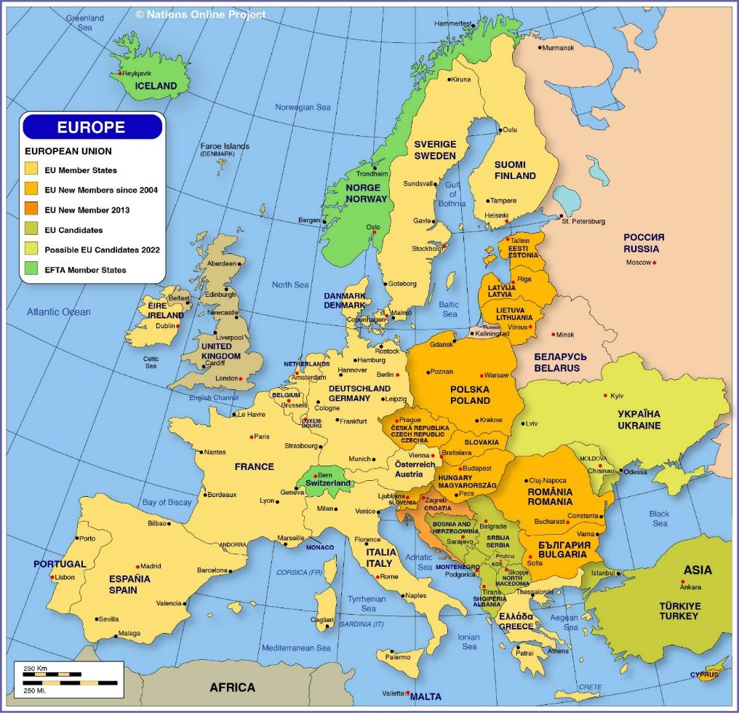
Ukraine and people in Ukraine defend all world!
Official information for those
who are interested to HELP Ukraine: https://war.ukraine.ua/support-ukraine/
SpivDiia:
https://spivdiia.org.ua/en
For education and science reconstruction and restoration: https://mon.gov.ua/eng/united24-zbir-koshtiv-na-vidbudovu-sferi-osviti-ta-nauki-ukrayini
UNITED24
https://u24.gov.ua/
https://supportukrainenow.org/
Ukraine needs more anti missile defence systems and weapons
to protect civilians – please help!!!

Slide 32
You are welcome to contact for help National Erasmus+ Office and Higher Education Reform Experts – team
#StandWithUkraine
Contacts in Ukraine:
Website: erasmusplus.org.ua, office@erasmusplus.org.ua
Facebook: NEOinUkraine, Skype: erasmusplus_ua
Tel.: +38 099 332 26 45 (Viber, WhatsApp, Telegram)
Viber/WhatsApp: +380505966045 – 24/7 (Svitlana Shytikova)
Tel:+38 095 332 26 45 (Viber, WhatsApp, Telegram)
Official HELP Ukraine:
https://war.ukraine.ua/support-ukraine/

